Slide 1

Hospital BI Solution
Patient Experience & Operational Efficiency
32,778
5
Patient Visits
Departments
January 2026 | Lyna Adalet, Tasnim BenDhia, Khalil Louhichi, Leila Baccouche
1

Slide 2
Project Agenda
Step 1
Business Understanding
Identify problem, KPIs, questions
Step 2
Data Preparation
Clean & transform raw data
Step 3
Data Modeling & Dashboard Develpoment
Star schema & measures
2
Step 4
Dashboards
Interactive visualizations
Step 5
Insights & Actions
Findings & recommendations

Slide 3
The Business Problem
Challenge
Patient satisfaction declining due to long waiting times
Target
Reduce average wait from 80–90 min → < 30 min
Satisfaction Goal
Increase average satisfaction rate
3

Slide 4

10 Analytical Questions
Average waiting time by department?
Busiest hours & worst wait times?
Days with longest waits?
Wait impact on satisfaction?
Doctor performance & efficiency?
% visits exceeding 30-min target?
Wait times by age group?
Wait & satisfaction by department?
Peak hour analysis?
Complaint patterns & drivers?
4

Slide 5
8 Core KPIs
KPI #1
KPI #5
Avg Wait Time
Patient Volume
KPI #2
KPI #6
Satisfaction
Doctor Utilization Rate
KPI #3
KPI #7
% Over 30-min
No-Show Rate
KPI #4
KPI #8
Treatment Duration
Complaint Rate
5
KPI #6
Doctor Util.
KPI #7
No-Show %
KPI #8
Complaint %

Slide 6
Data Preparation & ETL
Cleaning Steps
Data Sources
Removed 532 null records
Removed 123 duplicates
Filtered outliers (>180 min wait)
Standardized data types
Healthcare dataset
Appointment records
Satisfaction audit
Merged on index key
6
Output
32,778 clean visits
16 final columns
Ready for modeling
Full data dictionary

Slide 7
Star Schema Design
Central Fact Table: fact_visit
dim_patient
dim_doctors
dim_appointment
dim_hour
Age group, Condition, Name
Doctor ID, Name, Specialization
Hour ID, Appointment Hour
Date, Day, Time
Enables analysis by patient, doctor, time, condition, and hour
7

Slide 8
DAX Measures (Sample)
Avg Waiting Time
AVERAGE(fact_visit[waiting_time])
Avg Satisfaction
AVERAGE(fact_visit[Satisfaction])
% Exceeding 30-min Target
DIVIDE(COUNTIFS(fact_visit[waiting_time], ">30"), COUNTA(fact_visit[appointment_id]), 0)*100
Complaint Rate %
DIVIDE(COUNTIF(fact_visit[Complaint], 1), COUNTA(fact_visit[appointment_id]), 0)*100
8
DIVIDE(COUNTIF(Complaint=1), ...)*100
Doctor Utilization
(SUM(duration)*100)/(doctors*480)
Patient Volume
COUNTA(fact_visit[visit_id])

Slide 9
Executive Summary Dashboard
Avg Waiting Time
41.96 min
Avg Satisfaction
4.10/5.0
Patient Volume/Hour
3.3K
Complaint Rate
26.66
9
Doctor Utilization
4.25%
No-Show Rate
22.85%
Complaint Rate
26.66%

Slide 10
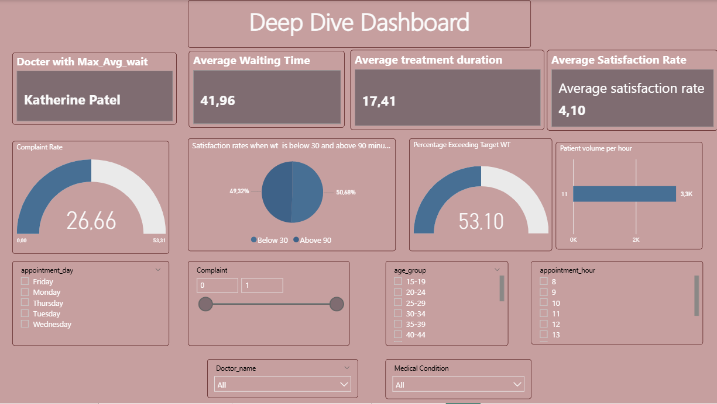
Deep Dive Dashboard
10

Slide 11
Finding 1: Afternoon Congestion
Morning: 15–31 min avg wait
Afternoon (2–5 PM): 46–60 min avg wait
Peak (5 PM): 60.5 min wait 🔴 Worst
Impact: 3,200 afternoon visits × 25-30 min excess = 80K–96K patient-minutes wasted daily
11

Slide 12
Finding 2: Tuesday Overload
44.0 min
Tuesday Avg Wait
vs.
39.7–39.8 min
Wed–Fri Avg Wait
6,557 visits on Tuesday | 10.8% degradation | Root cause: Weekend backlog
12

Slide 13
Finding 3: 90-Minute Satisfaction Cliff
Wait ≤ 30 min
4.12/5.0
47% of visits
Wait 30–90 min
4.10/5.0
27% of visits
Wait > 90 min
4.01/5.0
12% of visits
13
3,894 vulnerable patients exceed 90-min threshold; disproportionate complaint risk

Slide 14
Why This Matters: Business Impact
Patient Retention Risk
26.7% complaint rate threatens referrals & lifetime value
Operational Waste
53% exceeding 30-min = 80K+ wasted patient-minutes daily
Staff Burnout
60-min afternoon waits create provider fatigue & care quality risk
14

Slide 15
6 Prioritized Recommendations
🟢 R1: Dynamic Afternoon Scheduling (30 days) → Shift visits to morning/evening
🟢 R2: Tuesday Surge Capacity (45 days) → Add staff or move appointments
🟡 R3: 90-Min Breach Protocol (Immediate) → Alert managers, service recovery
🟡 R4: Complaint Root-Cause Survey (60 days) → QR-code feedback loop
🟡 R5: Staff Schedule Rebalancing (60 days) → Align shifts with demand
🟢 R6: Peak-Hour Appointment Cap (15 days) → Limit overbooking
15

Slide 16
Expected Impact & Timeline
Quick Wins (0–30 days)
Reduce afternoon wait 5–10 min | Peak-hour cap + 90-min alerts
Short-term (30–60 days)
Tuesday/Wed variance eliminated | Complaint rate 26.7% → 18–20%
Medium-term (60–180 days)
10–20% operational efficiency gain | Staff utilization optimized
16

Slide 17
Next Steps & Conclusion
Immediate Actions
Implement dynamic afternoon scheduling (30 days)
Launch 90-minute alert system
Begin complaint root-cause survey
10–20% efficiency gains achievable within 6 months
17

